Slide 1

Jan 5 2026
Parameter Setting
ClaymoreUW using Material Point Method
: Running Sample simulation
Youngchul choi
Master’s Student in Coastal Hazards Lab at The University of Texas at Austin
Notes:
Today, I’d like to give you a quick introduction to ClaymoreUW, the tsunami modeling tool I’ve been using.
I’ll walk you through what it is and show you how to run a sample simulation using it.

Slide 2
Items
Cuda setting
Simulation setting
Input Parameters
Notes:
Here’s how the tutorial will go:
First, we’ll clone the ClaymoreUW GitHub repository, set up the simulation environment, and compile it locally.
The compilation usually takes about over 30 minutes, so while that’s happening, I’ll explain how to set input parameters—things like wave types, bathymetry, debris, sensors, and forest structures—and then run a sample simulation.
We’ll also take a quick look at the output.

Slide 3
Process 1: CUDA setting
Change the corresponding GPUs compute capability architecture
  vim setup_cuda.cmake
    set(TARGET_CUDA_ARCH -arch=sm_89)
    set(CMAKE_CUDA_ARCHITECTURES 89)
Check specs
  nvidia-smi
    ex) NVIDIA RTX 2000 Ada Generation
  nvcc --version
    ex) cuda_12.0
    sudo apt-get install cuda-12-0
  gcc --version
    ex) gcc (Ubuntu 10.5.0-1ubuntu1~22.04) 10.5.0
    sudo update-alternatives --install /usr/bin/gcc gcc /usr/bin/gcc-9 10
Notes:
Let’s open the terminal in VS Code, go into WSL, and clone the GitHub repository.
This will copy all the necessary program files into your WSL folder.
But to actually run the program, you need to compile it locally.
Before you compile, make sure to edit your .cmake file depending on your GPU setup, and check that your nvcc and gcc versions are compatible—otherwise, you’ll get build errors at the next step.

Slide 4
Process 2: Simulation Setting
After Build and before Compile you must adjust Setting.h
  cd Projects/OSU_LWF/setting.h
    // * GPU set-up.
    constexpr int g_device_cnt = 1; //< IMPORTANT. Num. GPUs to compile for. Default 1. → 3
    // * Grid set-up
    #define DOMAIN_BITS 11 //< Domain resolution. 8 -> (2^8)^3 grid-nodes. Increase = finer grids. → 12
    // * Grids
    constexpr int g_max_active_block = 25000; //< Max active blocks in gridBlocks. Preallocated, can resize. Lower = less memory used. → 200,000
    // * Particles
    constexpr int g_max_particle_num = 4000000; //< Max no. particles. Very important, affects memory usage and performance. Preallocated, can resize. → 200,000,000
Notes:
Now, here’s how you build the program locally.
Just follow the steps shown here—it usually takes more than 30 minutes, so I’ll skip this part.
But if you have question on this step, please reach out to me because it requires some trouble shooting depending on your gpu model.
One important thing:
Before you run sh local_build.sh, go into Projects/OSU_LWF/setting.h and adjust the simulation settings as needed.
For example, if you want to use multiple GPUs or run a high-resolution simulation with 2.5 cm grid size, you’ll need to set that up here before compiling, so the changes are actually applied.
여기서 못기다리니까, ClaymoreUW_Tutorial/my-claymore 폴더가서
바로 JSON 파일 설명

Slide 5
Process 3: Input Parameters
Key Parameters Overview (Bonus, 2023 – 4.8 ClaymoreUW User Guide; p76)
  "simulation": { }
  "models": [{ }]
    "device": {...},
    "material": {...},
    "algorithm": {...},
    "geometry": [{...}, ...],
    "output": {...},
  "grid-boundaries": [{...}, ...],
  "grid-sensors": [{...}, ...],
  "particle-sensors": [{...}, ...]
Notes:
# local build 방법 - window OS
- WSL2 설치/열기 (WSL 혹은 VS code)
0. 인터넷 연결
Sudo nano /etc/resolv.conf
Nameserver 8.8.8.8
Nameserver 8.8.4.4
Github에서 a local install of ClaymoreUW public repo:
cd ~
git clone https://github.com/youngdie07/claymore.git
(https://github.com/youngdie07/claymore/tree/master)
cd claymore
sudo apt install build-essential
nvidia-smi
- ex) NVIDIA GeForce RTX 4090
nvcc --version
- ex) cuda_12.0
gcc --version
- ex) gcc (Ubuntu 13.3.0-6ubuntu2~24.04) 13.3.0

Slide 6
Process 3: Input Parameters
Key Parameters Overview (Bonus, 2023 – 4.8 ClaymoreUW User Guide; p76)
  "simulation": { } - grid size, time-step, duration, frame per second, etc.
  "models": [{ }] - fluid, solid box, etc.
    "device": {...},
    "material": {...},
    "algorithm": {...},
    "geometry": [{...}, ...],
    "output": {...},
  "grid-boundaries": [{...}, ...], - wall, bathymetry, structure
  "grid-sensors": [{...}, ...], - velocity, force, etc.
  "particle-sensors": [{...}, ...] - water level, location etc.
Notes:
# local build 방법 - window OS
- WSL2 설치/열기 (WSL 혹은 VS code)
0. 인터넷 연결
Sudo nano /etc/resolv.conf
Nameserver 8.8.8.8
Nameserver 8.8.4.4
Github에서 a local install of ClaymoreUW public repo:
cd ~
git clone https://github.com/youngdie07/claymore.git
(https://github.com/youngdie07/claymore/tree/master)
cd claymore
sudo apt install build-essential
nvidia-smi
- ex) NVIDIA GeForce RTX 4090
nvcc --version
- ex) cuda_12.0
gcc --version
- ex) gcc (Ubuntu 13.3.0-6ubuntu2~24.04) 13.3.0

Slide 7
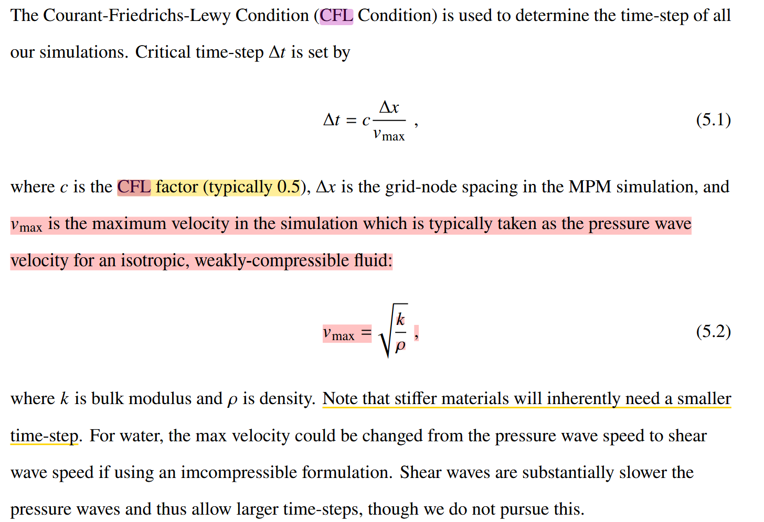
Process 3: Input Parameters
Key Parameters Overview - simulation
"simulation": {
"gravity": [0.0, -9.80665, 0.0],
"fps": 10,
"frames": 320,
"time": 0,
"default_dt": 0.5e-4,
"default_dx": 0.05,
"domain": [90, 4.5, 3.65],
"save_suffix": ".bgeo",
"particles_output_exterior_only": false,
"froude_scaling": 1.0
},
Notes:
# local build 방법 - window OS
- WSL2 설치/열기 (WSL 혹은 VS code)
0. 인터넷 연결
Sudo nano /etc/resolv.conf
Nameserver 8.8.8.8
Nameserver 8.8.4.4
Github에서 a local install of ClaymoreUW public repo:
cd ~
git clone https://github.com/youngdie07/claymore.git
(https://github.com/youngdie07/claymore/tree/master)
cd claymore
sudo apt install build-essential
nvidia-smi
- ex) NVIDIA GeForce RTX 4090
nvcc --version
- ex) cuda_12.0
gcc --version
- ex) gcc (Ubuntu 13.3.0-6ubuntu2~24.04) 13.3.0

Slide 8
Process 3: Input Parameters
Key Parameters Overview – models – device / material
"bodies": [
{
"gpu": 0,
"model": 0,
"material": {
"type": "particles",
"constitutive": "JFluid",
"CFL": 0.425,
"rho": 998.0,
"bulk_modulus": 2.0e8,
"gamma": 7.125,
"viscosity": 0.001
},
Notes:
CFL number is a dimensionless parameter, typically between 0 and 1, that determines the stability of the numerical scheme
Bulk modulus : a measure of the ability of a substance to withstand changes in volume when under compression (2.2 Gpa)

Slide 9
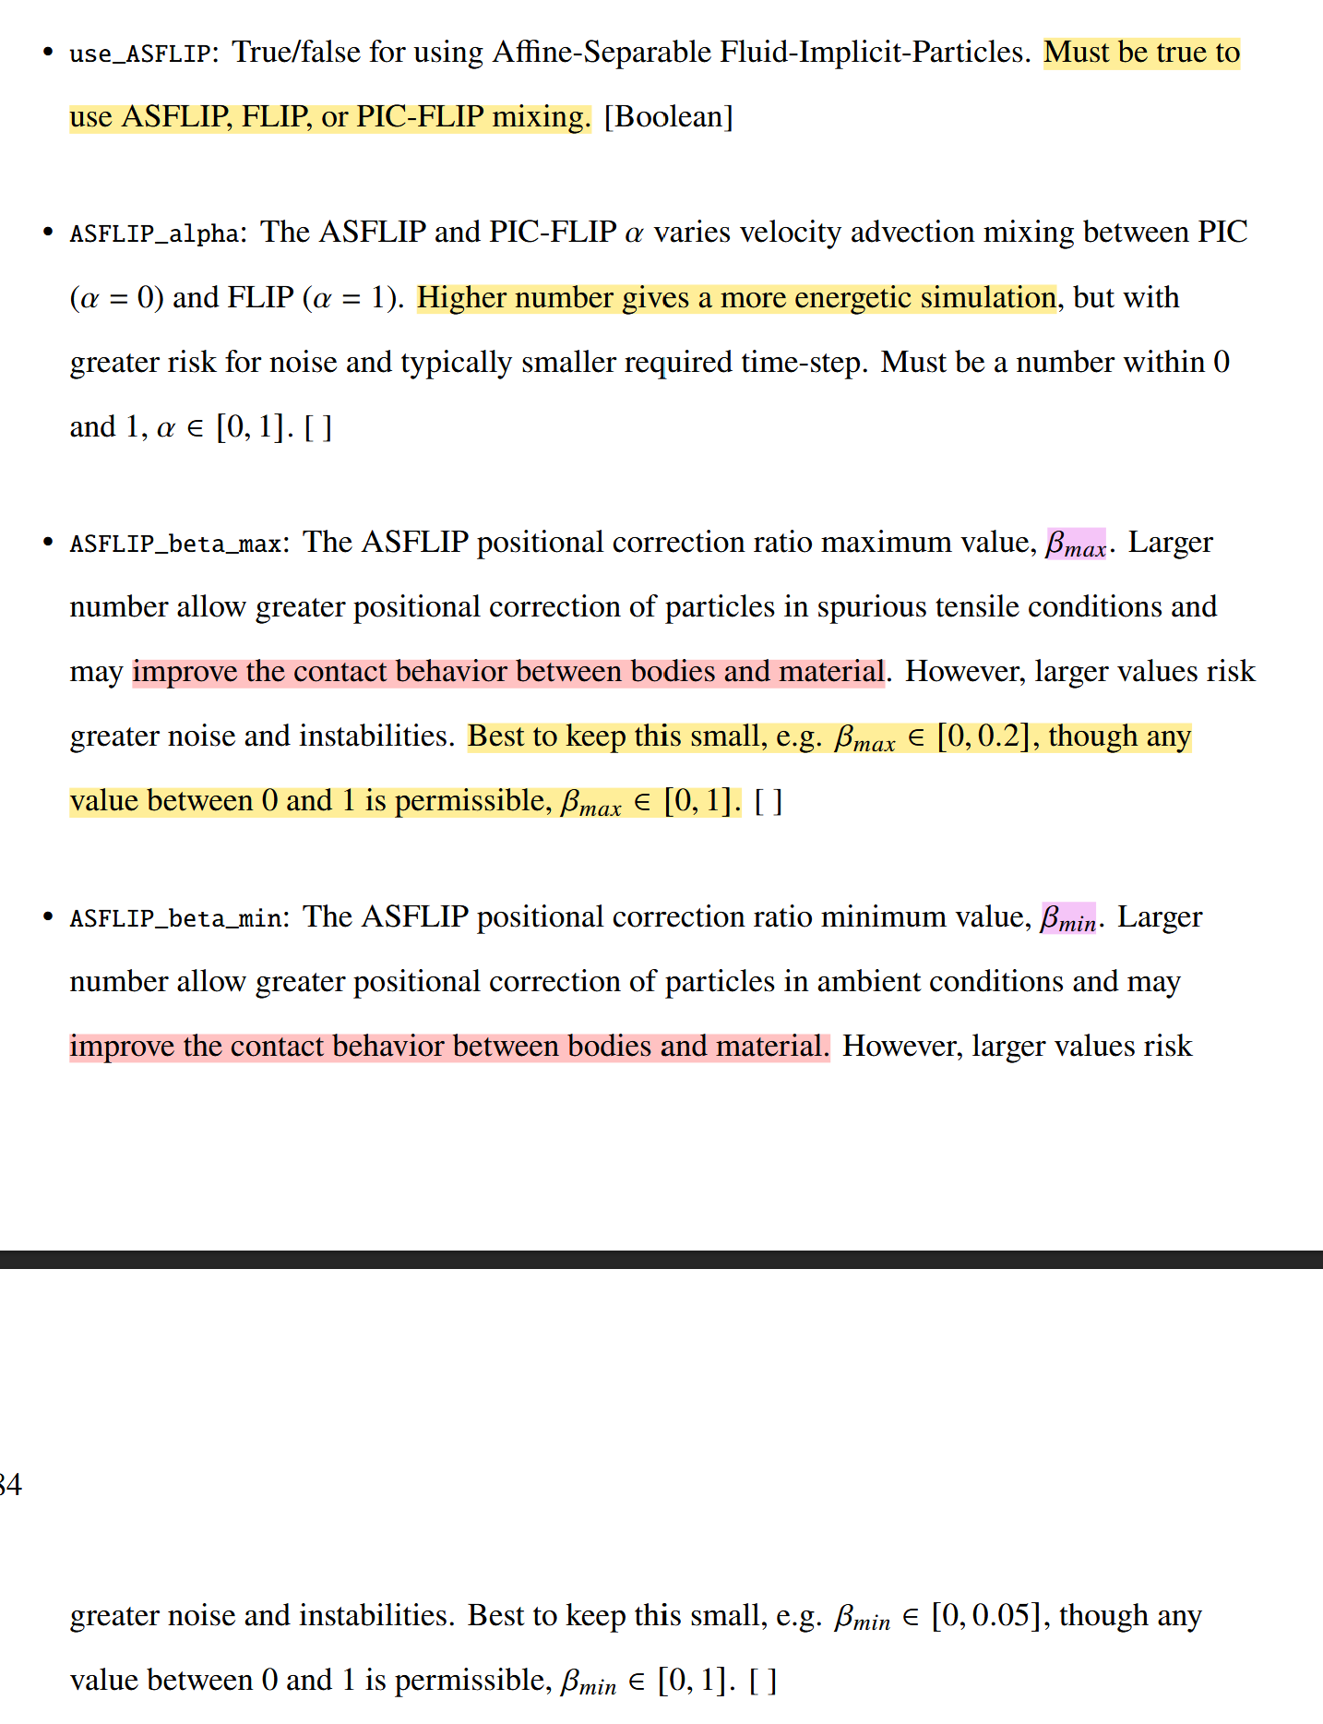
Process 3: Input Parameters
Key Parameters Overview – models- algorithm
"bodies": [
{
"algorithm": {
"ppc": 8.0000,
"use_FEM": false,
"use_ASFLIP": false,
"use_FBAR": true,
"ASFLIP_alpha": 0.0,
"ASFLIP_beta_min": 0.0,
"ASFLIP_beta_max": 0.0,
"FBAR_psi": 0.98,
"FBAR_fused_kernel": true
},
Notes:
# local build 방법 - window OS
- WSL2 설치/열기 (WSL 혹은 VS code)
0. 인터넷 연결
Sudo nano /etc/resolv.conf
Nameserver 8.8.8.8
Nameserver 8.8.4.4
Github에서 a local install of ClaymoreUW public repo:
cd ~
git clone https://github.com/youngdie07/claymore.git
(https://github.com/youngdie07/claymore/tree/master)
cd claymore
sudo apt install build-essential
nvidia-smi
- ex) NVIDIA GeForce RTX 4090
nvcc --version
- ex) cuda_12.0
gcc --version
- ex) gcc (Ubuntu 13.3.0-6ubuntu2~24.04) 13.3.0

Slide 10
Process 3: Input Parameters
Key Parameters Overview – models – geometry (fluid)
"bodies": [
{
"geometry": [
{
"object": "OSU LWF",
"operation": "Add",
"span": [88.1, 1.85, 0.05],
"offset": [1.9, 0.0, 0.0],
"array": [1, 1, 1],
"spacing": [0.0, 0.0, 0.0],
}
],
Notes:
It looks like the bathymetry coordinates are embedded in this file.

Slide 11
Process 3: Input Parameters
Key Parameters Overview – models – geometry(Custom)
"bodies": [
  {
  "object": "Box",
  "operation": "Add",
  "span": [88.1, 1.75, 3.65],
  "offset": [1.9, 0.0, 0.0]
  },
  {
  "object": "Bathymetry",
  "operation": "Subtract",
  "use_custom_bathymetry": true,
  "domain_start": [0,0,0],
  "domain_end": [90, 4.5, 3.65],
  "bathymetry": [
  [0.0, 0.175],
  [19.70, 0.175],
  [23.35, 0.175],
  [34.35, 1.125],
  [49.00, 1.725],
  [74.60, 1.725],
  [89.45, 2.625],
  [90.00, 2.625]
  ]
  }
],
Notes:
# local build 방법 - window OS
- WSL2 설치/열기 (WSL 혹은 VS code)
0. 인터넷 연결
Sudo nano /etc/resolv.conf
Nameserver 8.8.8.8
Nameserver 8.8.4.4
Github에서 a local install of ClaymoreUW public repo:
cd ~
git clone https://github.com/youngdie07/claymore.git
(https://github.com/youngdie07/claymore/tree/master)
cd claymore
sudo apt install build-essential
nvidia-smi
- ex) NVIDIA GeForce RTX 4090
nvcc --version
- ex) cuda_12.0
gcc --version
- ex) gcc (Ubuntu 13.3.0-6ubuntu2~24.04) 13.3.0

Slide 12
Process 3: Input Parameters
Key Parameters Overview – models – geometry(resume checkpoint)
"geometry": [
{
"object": "file",
"operation": "Add",
"file": "../cp/model[0]_dev[1]_frame[40].bgeo",
"spacing": [
0.0,
0.0,
0.05
],
"array": [
1,
1,
73
],
"has_attributes": true,
"input_attribs": [
"J",
"Velocity_X",
"Velocity_Y",
"Velocity_Z",
"JBar",
"ID"
]
}
]
Notes:
# local build 방법 - window OS
- WSL2 설치/열기 (WSL 혹은 VS code)
0. 인터넷 연결
Sudo nano /etc/resolv.conf
Nameserver 8.8.8.8
Nameserver 8.8.4.4
Github에서 a local install of ClaymoreUW public repo:
cd ~
git clone https://github.com/youngdie07/claymore.git
(https://github.com/youngdie07/claymore/tree/master)
cd claymore
sudo apt install build-essential
nvidia-smi
- ex) NVIDIA GeForce RTX 4090
nvcc --version
- ex) cuda_12.0
gcc --version
- ex) gcc (Ubuntu 13.3.0-6ubuntu2~24.04) 13.3.0

Slide 13
Process 3: Input Parameters
Key Parameters Overview – models – output
"bodies": [
{
"output_attribs": ["ID", "Pressure", "Velocity_X", "Velocity_Y"],
"track_attribs": ["Position_X"],
"target_attribs": ["Position_Y"],
"velocity": [0.0, 0.0, 0.0],
"track_particle_id": [0],
"partition_start": [0.0, 0.0, 0.0],
"partition_end": [89.1, 1.85, 0.05]
},
To use checkpoint – resume function.
Output_attributs must be set as ‘
"output_attribs": [
"J",
"Velocity_X",
"Velocity_Y",
"Velocity_Z",
"JBar",
"ID"
],
Notes:
# local build 방법 - window OS
- WSL2 설치/열기 (WSL 혹은 VS code)
0. 인터넷 연결
Sudo nano /etc/resolv.conf
Nameserver 8.8.8.8
Nameserver 8.8.4.4
Github에서 a local install of ClaymoreUW public repo:
cd ~
git clone https://github.com/youngdie07/claymore.git
(https://github.com/youngdie07/claymore/tree/master)
cd claymore
sudo apt install build-essential
nvidia-smi
- ex) NVIDIA GeForce RTX 4090
nvcc --version
- ex) cuda_12.0
gcc --version
- ex) gcc (Ubuntu 13.3.0-6ubuntu2~24.04) 13.3.0

Slide 14
Process 3: Input Parameters
Key Parameters Overview – grid boundaries
  "boundaries": [
  {
  "type": "grid",
  "object": "Wall",
  "contact": "Separable",
  "domain_start": [0.0, 0.0, 0.0],
  "domain_end": [90, 4.5, 0.05],
  "time": [0, 180]
  },
  {
  "type": "grid",
  "object": "OSU LWF",
  "contact": "Separable",
  "domain_start": [0.0, 0.0, 0.0],
  "domain_end": [90, 4.5, 0.05],
  "time": [0, 180]
  }
Notes:
It looks like the bathymetry coordinates are embedded in this file.

Slide 15
Process 3: Input Parameters
Key Parameters Overview - grid-boundaries
  "boundaries": [
  {
  "type": "grid",
  "object": "Box",
  "contact": "Separable",
  "domain_start": [45.79, 2.1, 0.0],
  "domain_end": [46.86, 2.715, 1.016],
  "time": [0, 180]
  },
Notes:
# local build 방법 - window OS
- WSL2 설치/열기 (WSL 혹은 VS code)
0. 인터넷 연결
Sudo nano /etc/resolv.conf
Nameserver 8.8.8.8
Nameserver 8.8.4.4
Github에서 a local install of ClaymoreUW public repo:
cd ~
git clone https://github.com/youngdie07/claymore.git
(https://github.com/youngdie07/claymore/tree/master)
cd claymore
sudo apt install build-essential
nvidia-smi
- ex) NVIDIA GeForce RTX 4090
nvcc --version
- ex) cuda_12.0
gcc --version
- ex) gcc (Ubuntu 13.3.0-6ubuntu2~24.04) 13.3.0

Slide 16
Process 3: Input Parameters
Key Parameters Overview – grid-boundaries
  "boundaries": [
  {
  "type": "grid",
  "object": "OSU Paddle",
  "contact": "Separable",
  "domain_start": [1.6, -0.2, -0.2],
  "domain_end": [2.0, 5, 4],
  "time": [0, 180],
  "file": "wmdisp_hydro2sec_1200hz_smooth_14032023.csv",
  "output_frequency": 1200
  }
  ],
Notes:
# local build 방법 - window OS
- WSL2 설치/열기 (WSL 혹은 VS code)
0. 인터넷 연결
Sudo nano /etc/resolv.conf
Nameserver 8.8.8.8
Nameserver 8.8.4.4
Github에서 a local install of ClaymoreUW public repo:
cd ~
git clone https://github.com/youngdie07/claymore.git
(https://github.com/youngdie07/claymore/tree/master)
cd claymore
sudo apt install build-essential
nvidia-smi
- ex) NVIDIA GeForce RTX 4090
nvcc --version
- ex) cuda_12.0
gcc --version
- ex) gcc (Ubuntu 13.3.0-6ubuntu2~24.04) 13.3.0

Slide 17
Process 3: Input Parameters
Key Parameters Overview - grid-sensors
  "grid-sensors": [
  {
  "type": "grid",
  "attribute": "Force",
  "operation": "Sum",
  "direction": "X+",
  "output_frequency": 120,
  "domain_start": [45.790, 2.1, -0.2],
  "domain_end": [45.85, 2.615, 2.338]
  }
Notes:
# local build 방법 - window OS
- WSL2 설치/열기 (WSL 혹은 VS code)
0. 인터넷 연결
Sudo nano /etc/resolv.conf
Nameserver 8.8.8.8
Nameserver 8.8.4.4
Github에서 a local install of ClaymoreUW public repo:
cd ~
git clone https://github.com/youngdie07/claymore.git
(https://github.com/youngdie07/claymore/tree/master)
cd claymore
sudo apt install build-essential
nvidia-smi
- ex) NVIDIA GeForce RTX 4090
nvcc --version
- ex) cuda_12.0
gcc --version
- ex) gcc (Ubuntu 13.3.0-6ubuntu2~24.04) 13.3.0

Slide 18
Process 3: Input Parameters
Key Parameters Overview - particle-sensors
  "particle-sensors": [
  {
  "type": "particles",
  "attribute": "Elevation",
  "operation": "Max",
  "output_frequency": 120,
  "domain_start": [16.0, 1.0, 0.0],
  "domain_end": [16.1, 3.6, 1.0]
  }
  ]
  }
Notes:
# local build 방법 - window OS
- WSL2 설치/열기 (WSL 혹은 VS code)
0. 인터넷 연결
Sudo nano /etc/resolv.conf
Nameserver 8.8.8.8
Nameserver 8.8.4.4
Github에서 a local install of ClaymoreUW public repo:
cd ~
git clone https://github.com/youngdie07/claymore.git
(https://github.com/youngdie07/claymore/tree/master)
cd claymore
sudo apt install build-essential
nvidia-smi
- ex) NVIDIA GeForce RTX 4090
nvcc --version
- ex) cuda_12.0
gcc --version
- ex) gcc (Ubuntu 13.3.0-6ubuntu2~24.04) 13.3.0

Slide 19
References and Resources
Github repository
  https://github.com/youngdie07/debris-fluid-structure-simulation-MPM
  https://github.com/JustinBonus/claymore
  https://github.com/penn-graphics-research/claymore
References
  https://claymore.readthedocs.io/en/latest/
  Bonus, J. (2023). Evaluation of Fluid-Driven Debris Impacts in a High-Performance Multi-GPU Material Point Method. University of Washington.

